Slide 1
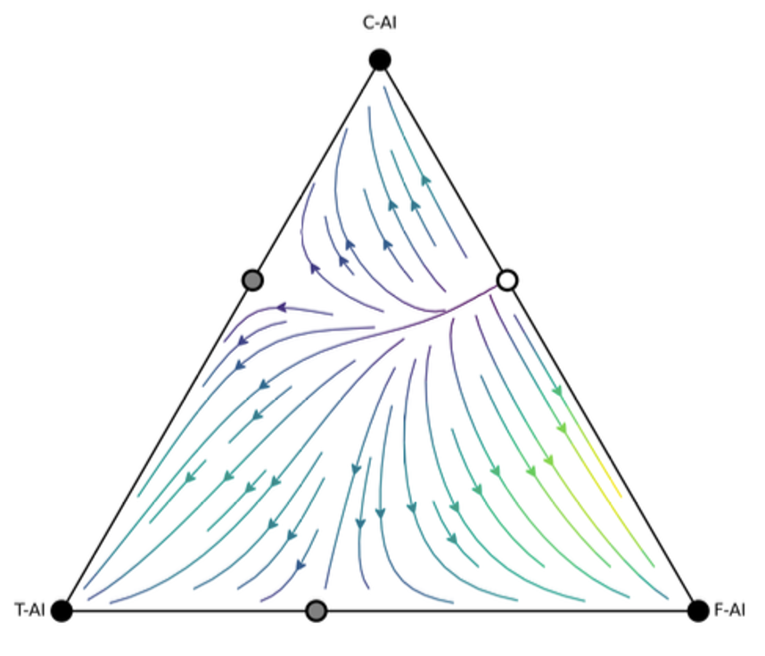
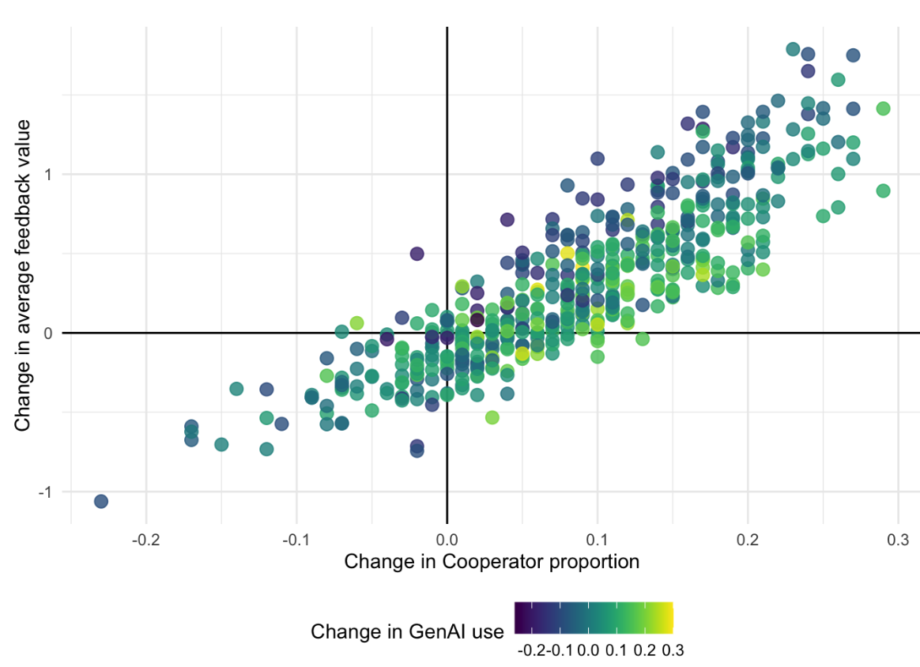


Game Theoretic Models of Intangible Learning Data
Ben Hicks (PhD candidate)
Kirsty Kitto
Connected Intelligence Centre
University of Technology Sydney
Notes:
I come from two worlds – mathematical and statistical modelling, and 12 years as a teacher. As such the LA v L alignment problem really resonates with me (almost personal),

Slide 2
Is the data in learning systems representative of learning processes?
Notes:
A question I keep coming back to.

Slide 3

LA: More about analytics than about learning?
Guzmán-Valenzuela C, Gómez-González C, Rojas-Murphy Tagle A, Lorca-Vyhmeister A. Learning analytics in higher education: a preponderance of analytics but very little learning? Int J Educ Technol High Educ. 2021;18(1):23. doi: 10.1186/s41239-021-00258-x. Epub 2021 May 4. PMID: 34778523; PMCID: PMC8092999.

Slide 4
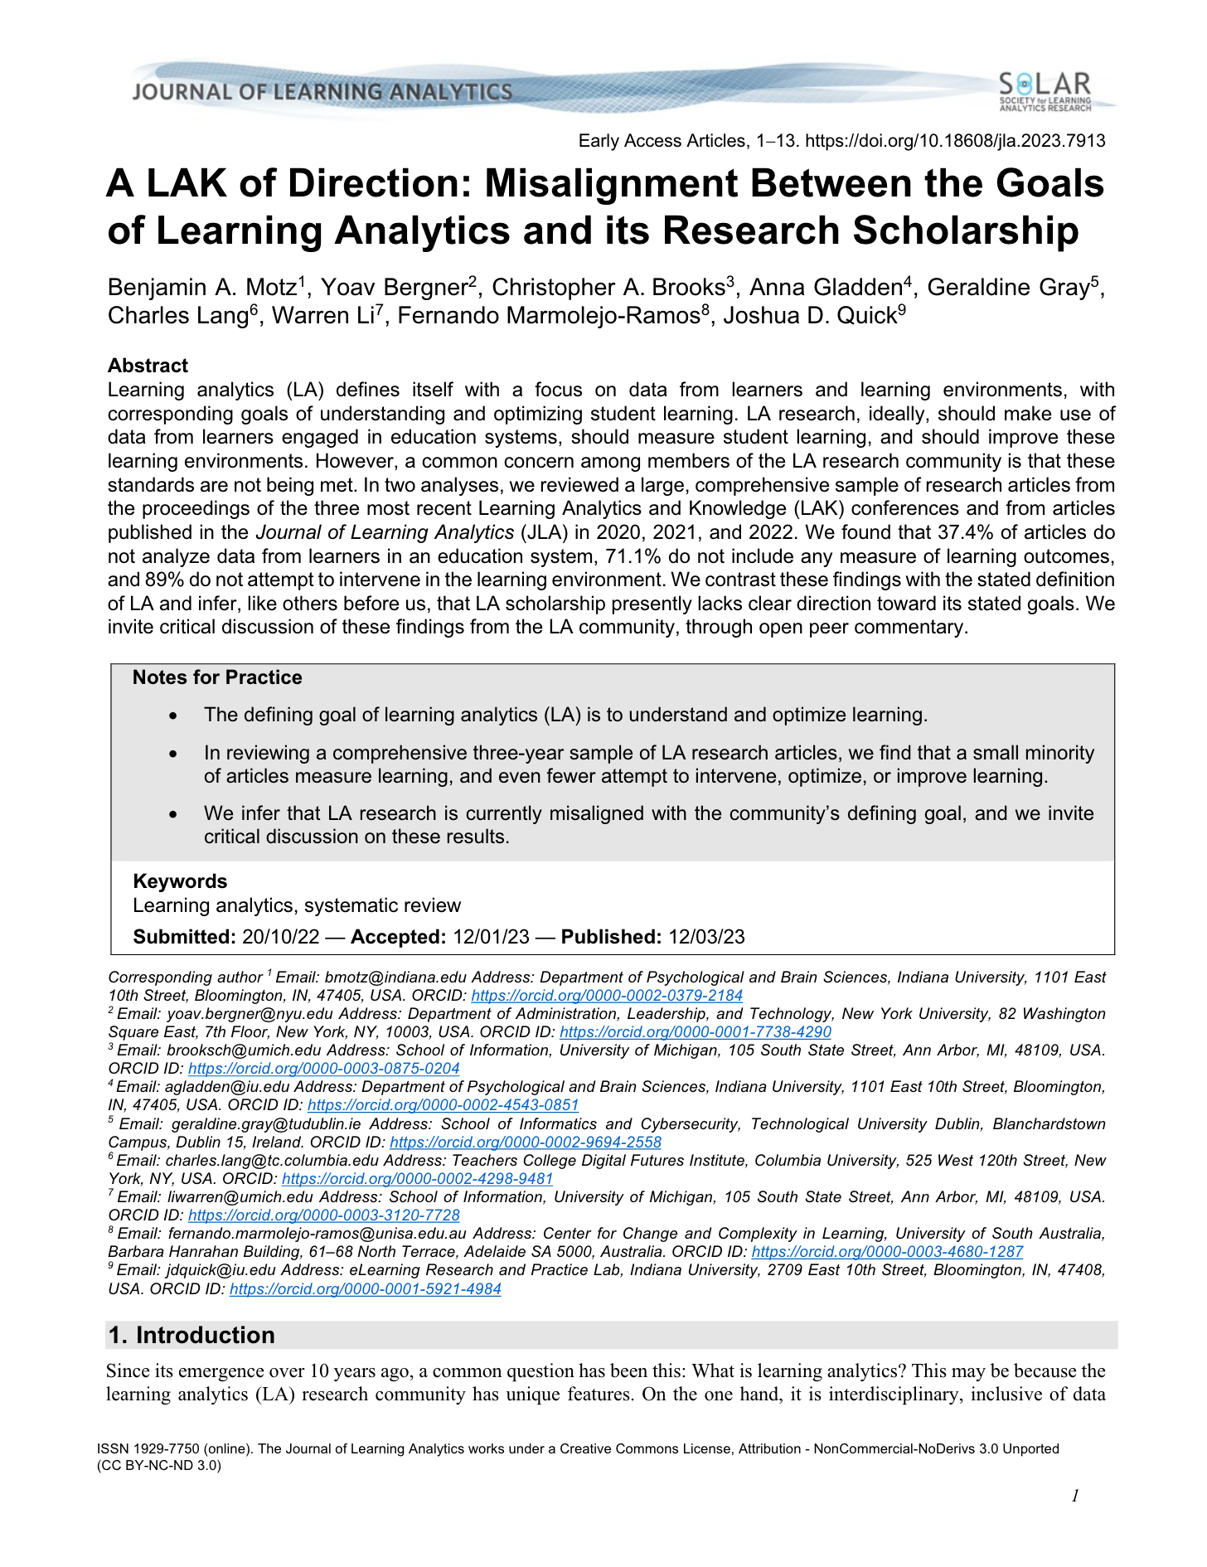
Misalignment between LA goals and research
Motz, B. A., Bergner, Y., Brooks, C. A., Gladden, A., Gray, G., Lang, C., Li, W., Marmolejo-Ramos, F., & Quick, J. D. (2023). A LAK of Direction: Misalignment Between the Goals of Learning Analytics and its Research Scholarship. Journal of Learning Analytics, 10(2), 1-13. https://doi.org/10.18608/jla.2023.7913

Slide 5
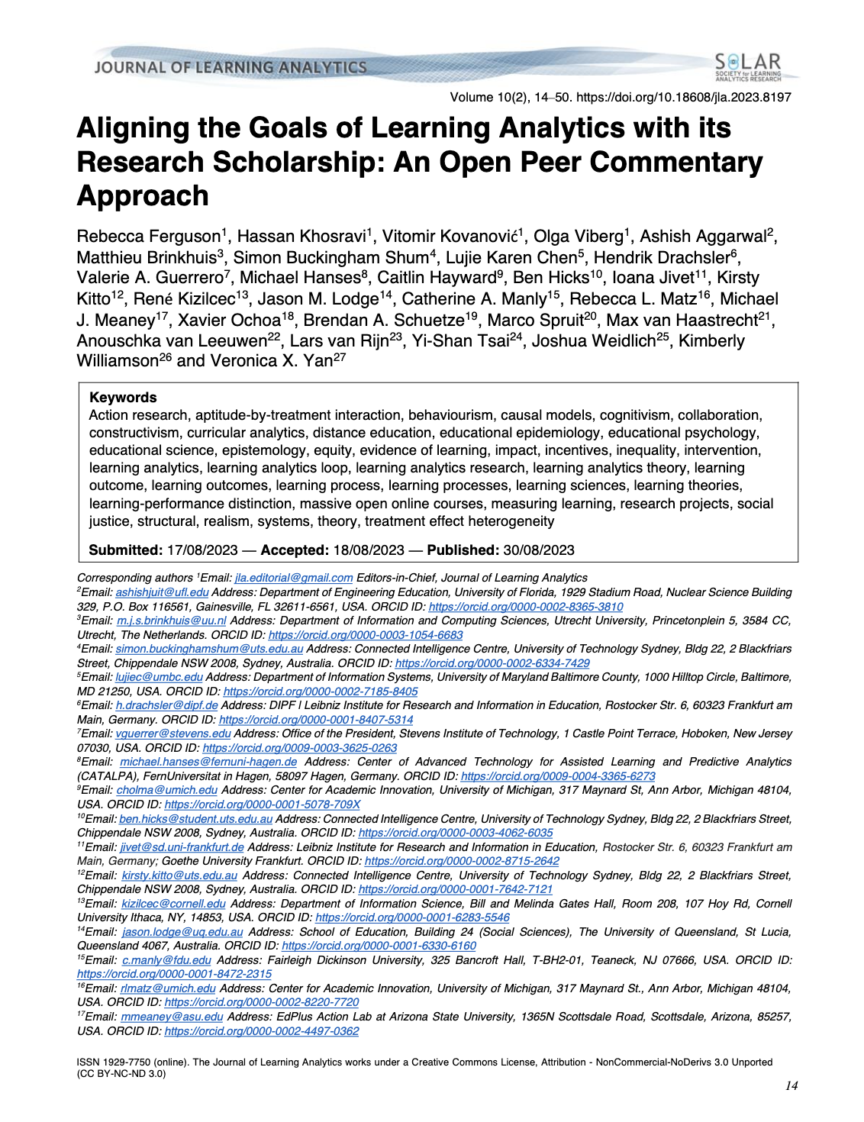
Learning outcomes and learning often conflated
Ferguson, R. ., Khosravi, H., Kovanović, V., Viberg, O., Aggarwal, A., Brinkhuis, M., Buckingham Shum, S., Chen, L. K., Drachsler, H., Guerrero, V. A., Hanses, M., Hayward, C., Hicks, B., Jivet, I., Kitto, K., Kizilcec, R., Lodge, J. M., Manly, C. A., Matz, R. L., Meaney, M. J., Ochoa, X., Schuetze, B. A., Spruit, M., van Haastrecht, M., van Leeuwen, A., van Rijn, L., Tsai, Y.-S., Weidlich, J., Williamson, K., & Yan, V. X. (2023). Aligning the Goals of Learning Analytics with its Research Scholarship: An Open Peer Commentary Approach. Journal of Learning Analytics, 10(2), 14-50. https://doi.org/10.18608/jla.2023.8197

Slide 6
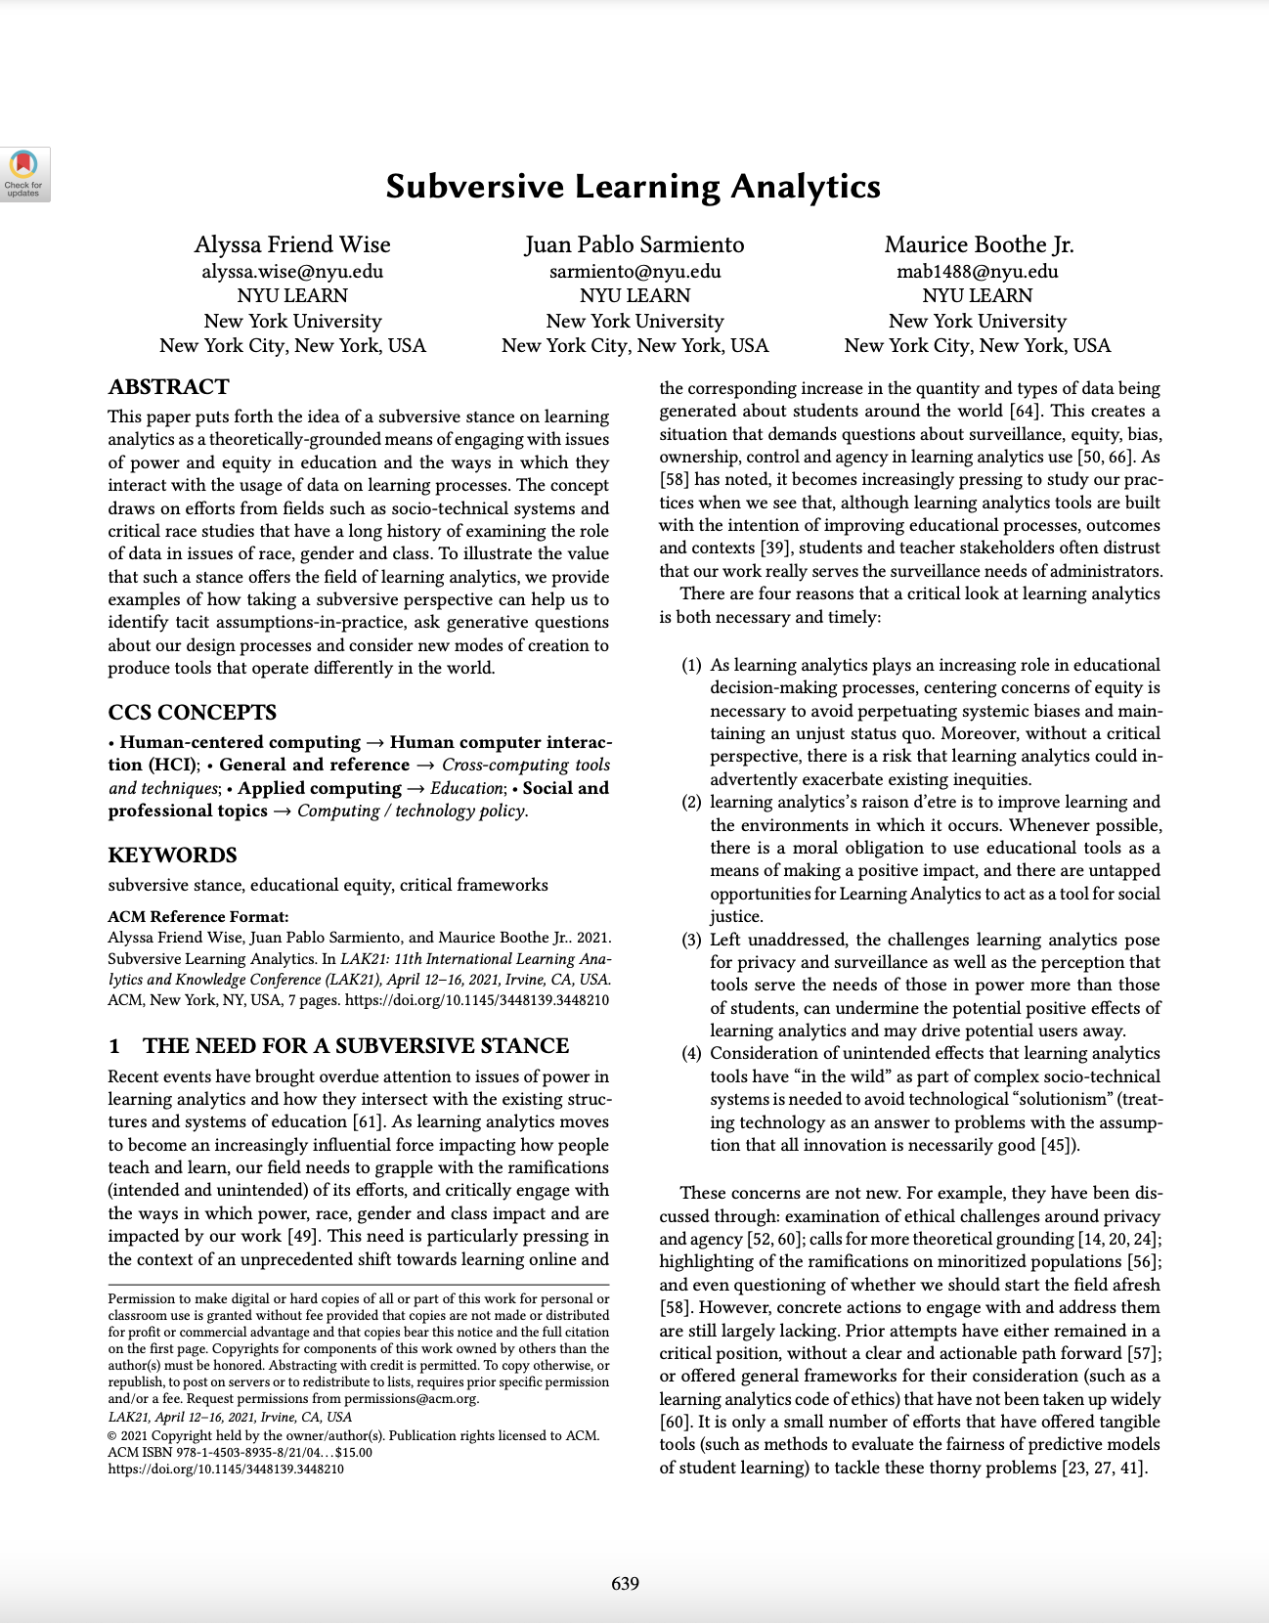
Missing data important to learning should be acknowledged
Alyssa Friend Wise, Juan Pablo Sarmiento, and Maurice Boothe Jr. 2021. Subversive Learning Analytics. In LAK21: 11th International Learning Analytics and Knowledge Conference (LAK21). Association for Computing Machinery, New York, NY, USA, 639–645. https://doi-org.ezproxy.lib.uts.edu.au/10.1145/3448139.3448210

Slide 7
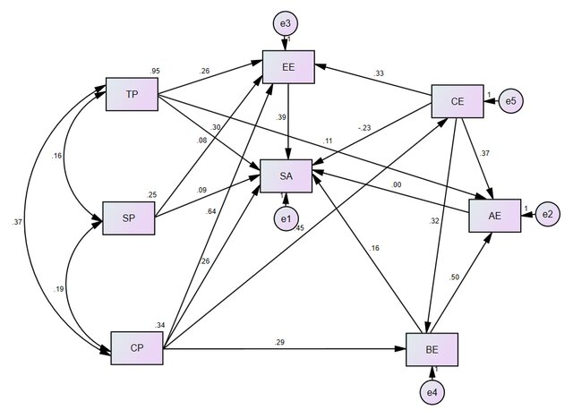
Methods for addressing missing data
Imputation – fill in missing examples from existing observations of the same thing
Modelling latent variables – build constructs from observations of a related thing
Kucuk, S., & Richardson, J. C. (2019). A Structural Equation Model of Predictors of Online Learners' Engagement and Satisfaction. Online Learning, 23(2), 196-216. Figure 2.
Notes:
SEM modelling pic

Slide 8
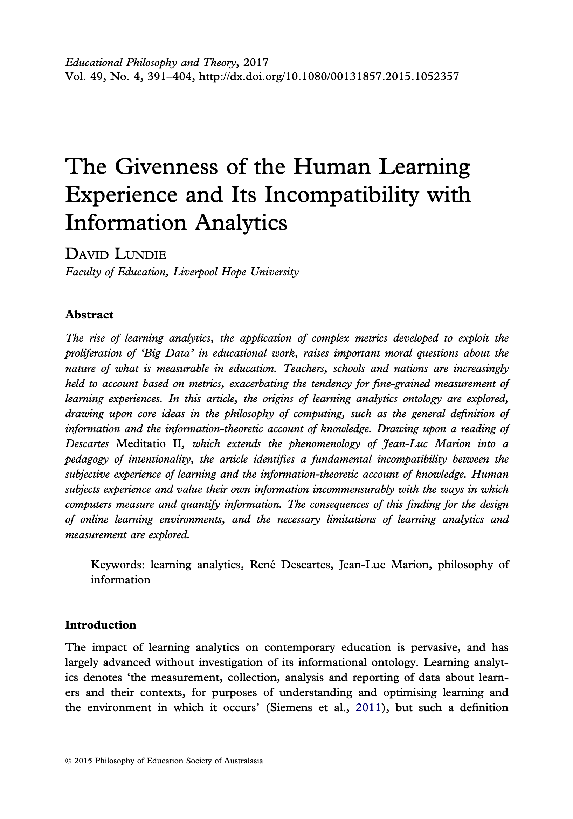
Critical aspects of learning are intangible
Lundie, D. (2015). The Givenness of the Human Learning Experience and Its Incompatibility with Information Analytics. Educational Philosophy and Theory, 49(4), 391–404. https://doi-org.ezproxy.lib.uts.edu.au/10.1080/00131857.2015.1052357
Notes:
LA knows this and works hard at it – strength of the field

Slide 9
We can get close…
LAK25
Curiosity
Exploration
Trace data
Joe Tang, Andrew Gibson, and Peter Bruza. 2025. Analysis of exploratory behaviour: A step towards modelling of curiosity. In Proceedings of the 15th International Learning Analytics and Knowledge Conference (LAK '25). Association for Computing Machinery, New York, NY, USA, 690–701. https://doi-org.ezproxy.lib.uts.edu.au/10.1145/3706468.3706561
Attention
Gaze
Video data
Grace D. Jaiyeola, Aaron Y. Wong, Richard L. Bryck, Caitlin Mills, and Stephen Hutt. 2025. One Size Does Not Fit All: Considerations when using Webcam-Based Eye Tracking to Models of Neurodivergent Learners’ Attention and Comprehension. In Proceedings of the 15th International Learning Analytics and Knowledge Conference (LAK '25). Association for Computing Machinery, New York, NY, USA, 24–35. https://doi-org.ezproxy.lib.uts.edu.au/10.1145/3706468.3706472
Confusion
Facial expression
Video data
Yu Fang, Shihong Huang, and Amy Ogan. 2025. A Cross-Cultural Confusion Model for Detecting and Evaluating Students’ Confusion In a Large Classroom. In Proceedings of the 15th International Learning Analytics and Knowledge Conference (LAK '25). Association for Computing Machinery, New York, NY, USA, 473–483. https://doi-org.ezproxy.lib.uts.edu.au/10.1145/3706468.3706528
Notes:
But not touch

Slide 10
A proposal for addressing intangible data
This paper explores a way to approach intangible aspects of learning, and how it might be linked to existing data, using Evolutionary Game Theory and simulation.
Notes:
I different approach. Not a proxy – but modelling. Strap in.

Slide 11
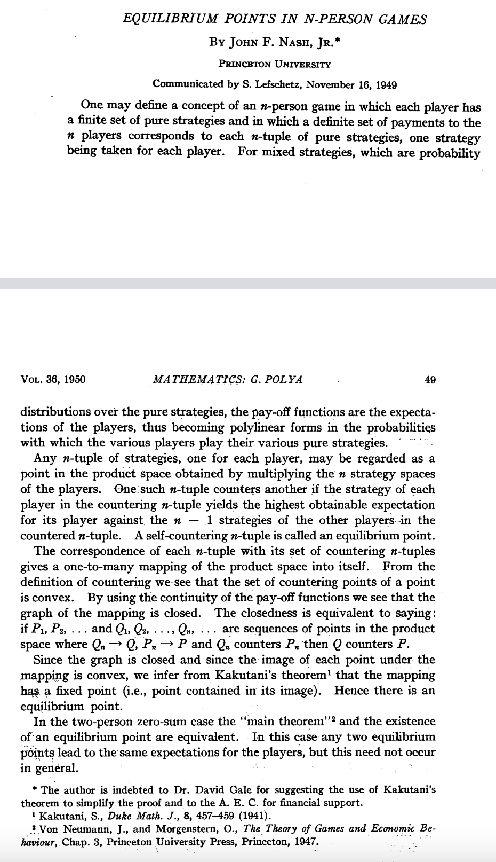
Game Theory
Mathematical analysis of games – what kind of strategies help players “win”.
Used to studying decision making under various scenarios (i.e. a hidden cognitive process).
Adopted mostly by economics.
& J.F. Nash, Equilibrium points in n-person games, Proc. Natl. Acad. Sci. U.S.A. 36 (1) 48-49, https://doi.org/10.1073/pnas.36.1.48 (1950).

Slide 12
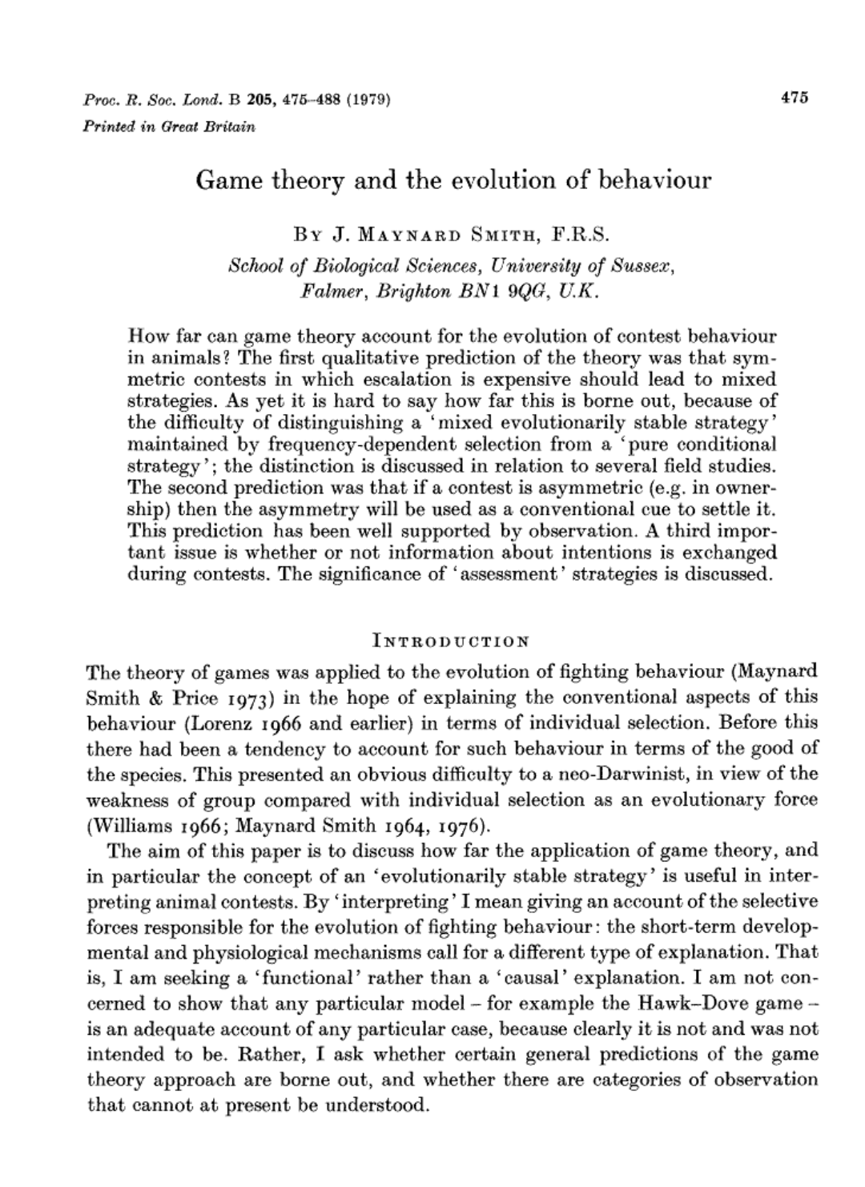
Evolutionary Game Theory
Studies strategies evolving over time. Hidden processes of numerous agents, over time.
Used as an improvement on Darwin’s theory of evolution.
Smith, J. M. (1979). Game theory and the evolution of behaviour. Proceedings of the Royal Society of London. Series B. Biological Sciences, 205(1161), 475-488.

Slide 13
Working with Evolutionary Game Theory models requires a different frame of reference.
Notes:
This is just a warning – will come back to it.

Slide 14








RQ: How can game theoretic models connect intangible data to the data that we have available in LA?
Describe what we can
Describe this formally in mathematics (in this case, the Game)
Simulate interactions to explore environments (the game evolves)
Collect system changes over a range of environments

Slide 15
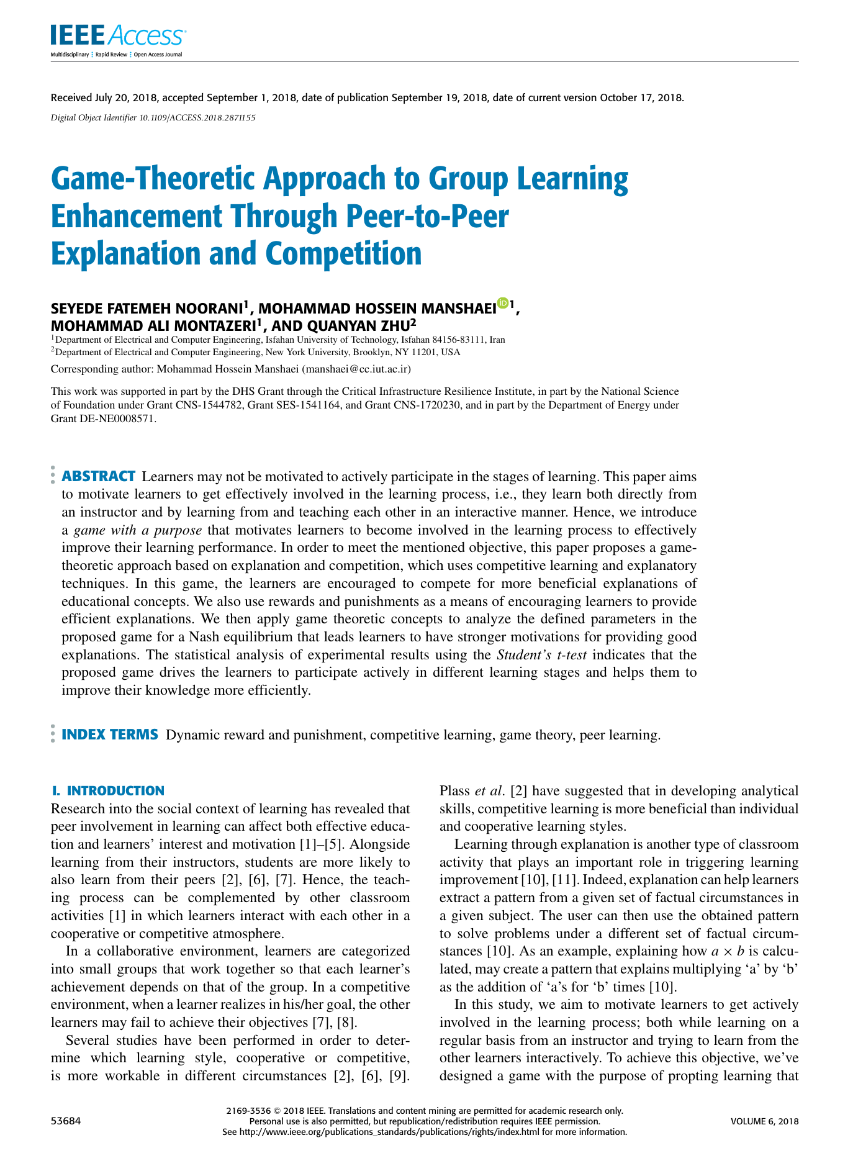
Modelling case study: Peer feedback
Learners are paired to give each other feedback on a piece of work.
This requires effort but also gives some benefits.
There is a tension between cooperative and “free-riding” behaviour.
Observing “effort” is extremely difficult.
S. F. Noorani, M. H. Manshaei, M. A. Montazeri and Q. Zhu, "Game-Theoretic Approach to Group Learning Enhancement Through Peer-to-Peer Explanation and Competition," in IEEE Access, vol. 6, pp. 53684-53697, 2018, doi: 10.1109/ACCESS.2018.2871155.
Notes:
Observation: Being honest with yourself about your own effort is hard enough.

Slide 16



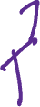




The Game

Slide 17









The Game
Students review each other’s work, and decide how much effort to put in.

Slide 18


The Game
They share this feedback with each other.

Slide 19




The Game
They incur some cost from completing the feedback, depending on how much effort they put in. This is their strategy.
The paper explores three strategies initially:
Cooperator, applying maximum effort.
Token-effort, applying half effort.
Free-rider, applying negligible effort.

Slide 20


The Game
They get some perceived value from the feedback (dependent on how much effort their fellow student put in)

Slide 21


The Game
They get some perceived value from the completing the feedback (depending on how much effort they put in).
Notes:
Many different paramaters!! What is the cost relative to the benefit. We don’t know them…but we will explore many

Slide 22
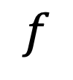
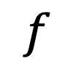
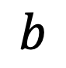
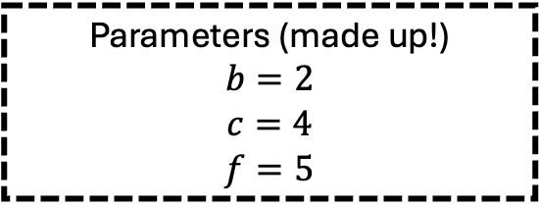
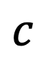
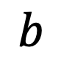
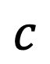
The Game
They get some perceived value from the completing the feedback (depending on how much effort they put in).
$$b$$
$$b$$
Parameters (made up!)
$$b=2$$
$$c=4$$
$$f=5$$
$$f$$
$$c$$
$$c$$
$$f$$
Notes:
Many different paramaters!! What is the cost relative to the benefit. We don’t know them…but we will explore many

Slide 23
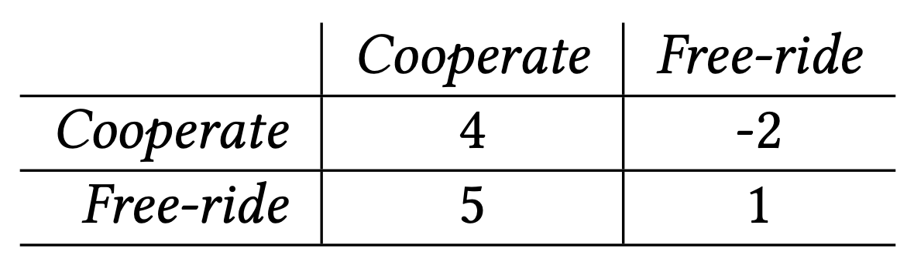









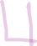

The Game
This “payoff” between strategies can be summarized in a payoff matrix
Parameters (made up!)
$$b=2$$
$$c=4$$
$$f=5$$
Notes:
Remember: the frame of reference!! This is for these parameters:::
Prisoners dilemma – well known and a behaviour we see in classrooms

Slide 24














The Game Evolves
We analyse lots of these interactions
Notes:
For a set of parameters we can explore the evolution of our imagined system.
But we need ot see …

Slide 25


The Game Evolves
After each feedback exchange, students decide how much effort they put in next time.
Notes:
They can change their strategy

Slide 26
Strategy evolution
We display the distribution of Cooperators, Token-effort, and Free-rider strategies:
Cooperator
Token-effort
Free-rider
Notes:
What strategy do students choose?

Slide 27
Strategy evolution
We display the distribution of Cooperator, Token-effort, and Free-rider strategies:
Cooperator
Token-effort
Free-rider

Slide 28
Strategy evolution
As students change strategy, the distribution moves:
Cooperator
Token-effort
Free-rider
Notes:
MULTIPLE GAMES / INTERACTIONS

Slide 29
Strategy evolution
As students change strategy, the distribution moves:
Cooperator
Token-effort
Free-rider

Slide 30
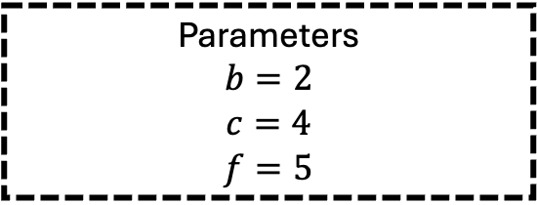
Strategy evolution
The system dynamics are our reference frame
Cooperator
Parameters
$$b=2$$
$$c=4$$
$$f=5$$
Token-effort
Free-rider
Notes:
What have we discarded? Location / amount of students. We are interested in movement

Slide 31
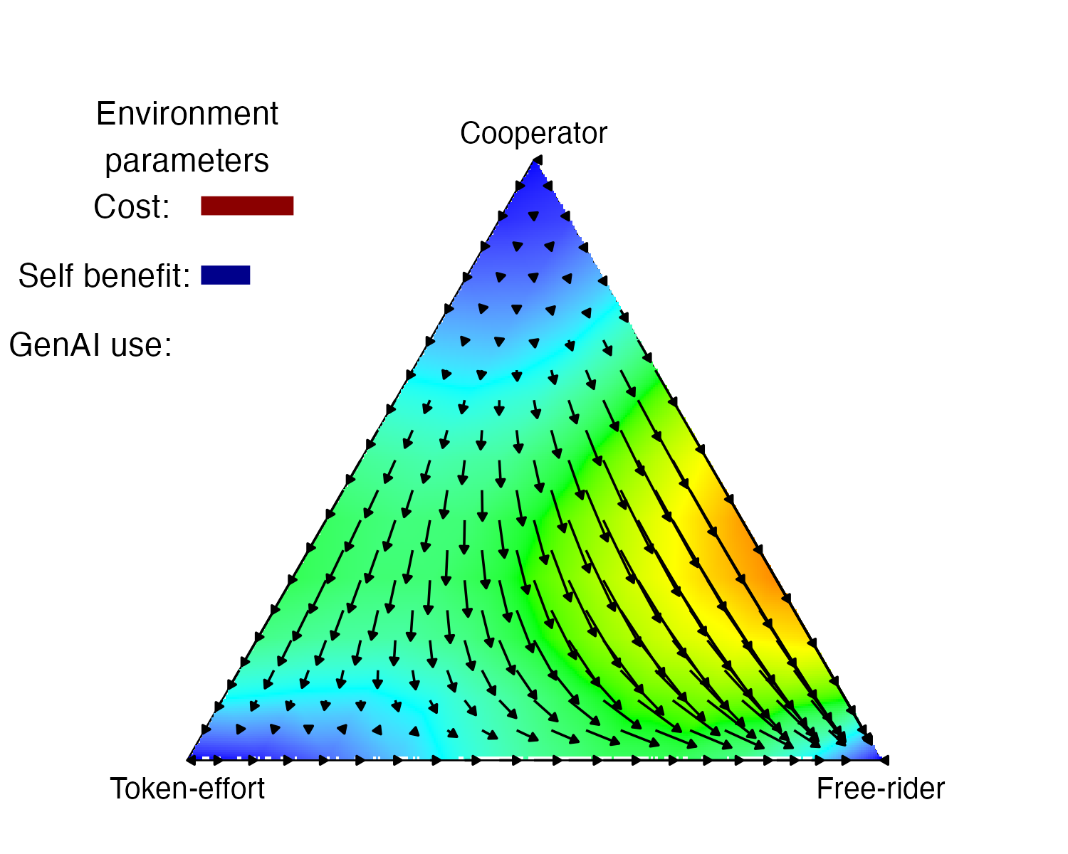

Strategy evolution
Under what conditions do we promote / impede cooperation?
Unstable:
Most change strategy
Stable:
Most keep strategy

Slide 32
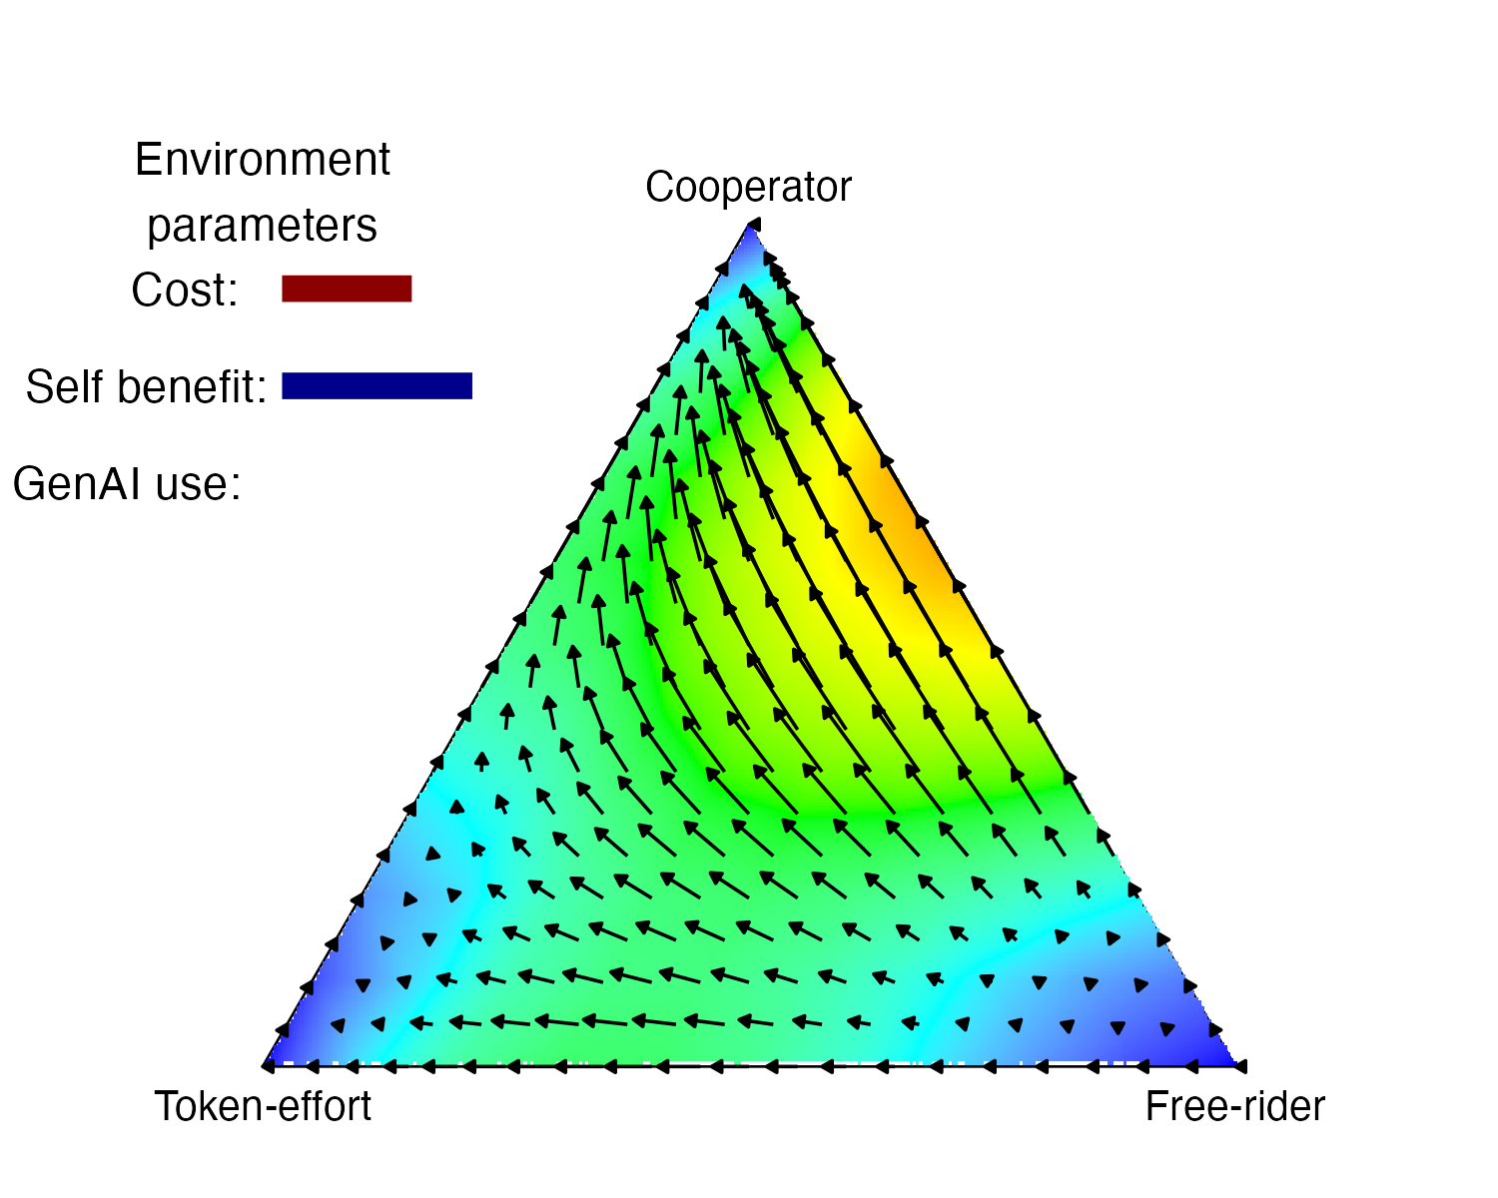
Strategy evolution
Under what conditions do we promote / impede cooperation?
Unstable:
Most change strategy
Stable:
Most keep strategy

Slide 33
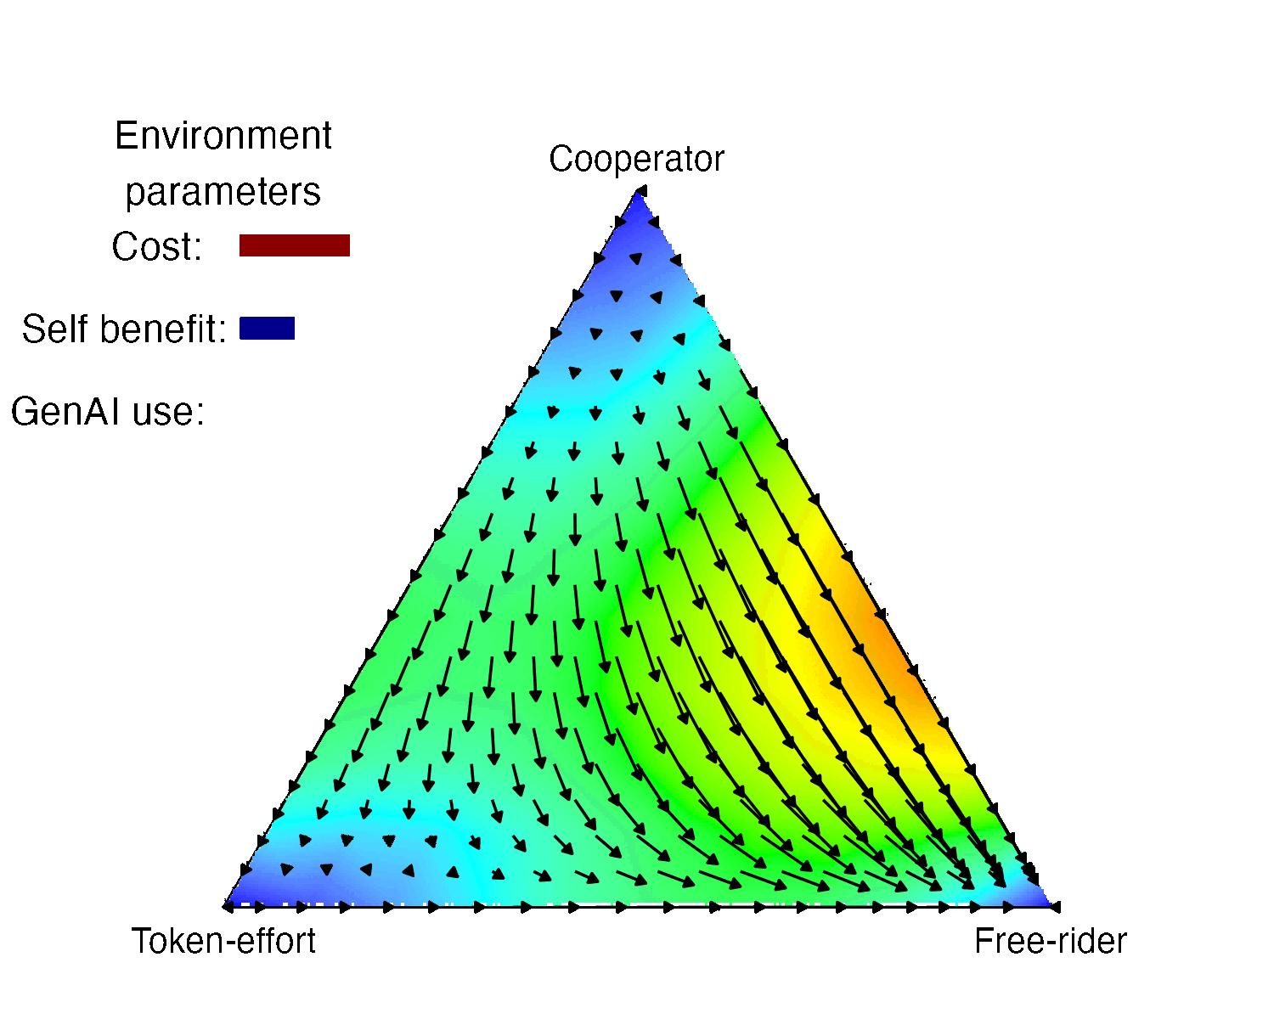
Strategy evolution
Under what conditions do we promote / impede cooperation?
Unstable:
Most change strategy
Stable:
Most keep strategy

Slide 34

Hypothetical: LLMs Invade!
Extra strategy choice:
How much to use GenAI to support providing feedback?
An increase in GenAI use will:
Lower the cost of providing feedback
Lower the self-benefit of providing feedback
Change the value of the feedback (depending on GenAI quality)
Notes:
We can imagine data that hasn’t happened yet

Slide 35
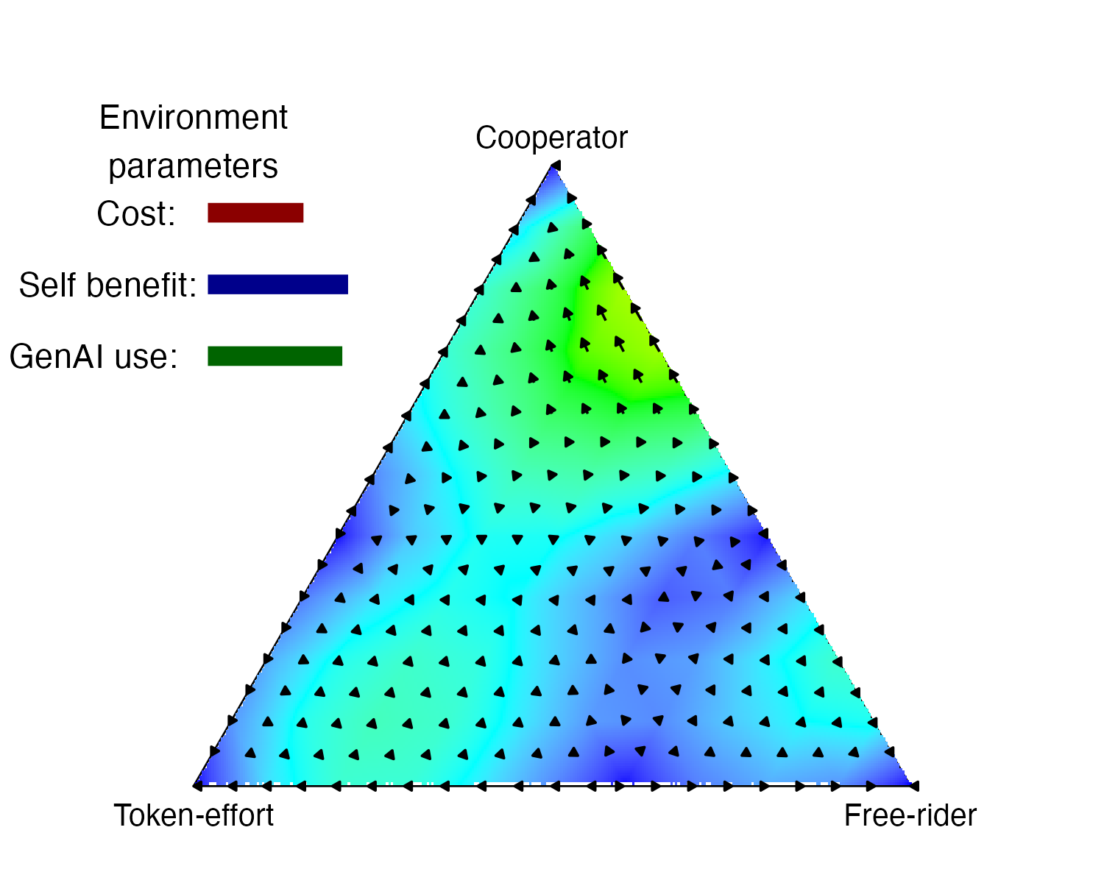
Strategy evolution
Under what conditions do we promote / impede cooperation?
Unstable:
Most change strategy
Stable:
Most keep strategy

Slide 36
Strategy evolution
Under what conditions do we promote / impede cooperation?
Unstable:
Most change strategy
Stable:
Most keep strategy
Notes:
Describe dampening. SLOWLY.
This is all very fun, but…

Slide 37
Data generation of what we might observe
Simulating:
Change …
Notes:
CHANGE is what we might observe (if not measure)

Slide 38
Data generation of what we might observe
Simulating:
Change in cooperation

Slide 39
Data generation of what we might observe
Simulating:
Change in cooperation
Change in learning impact of cooperation

Slide 40
Data generation of what we might observe
Simulating:
Change in cooperation
Change in learning impact of cooperation
Change in use of GenAI

Slide 41
Data generation of what we might observe
Simulating:
Change in cooperation
Change in learning impact of cooperation
Change in use of GenAI

Slide 42
What have we done?
Described a learning situation with no data…
…mathematically
Used this to model a range of scenarios
Collected this results to form a simulated data distribution
We’re not making claims about the future of cooperation and GenAI – but this proof of concept is a way we might see into the unknown.

Slide 43
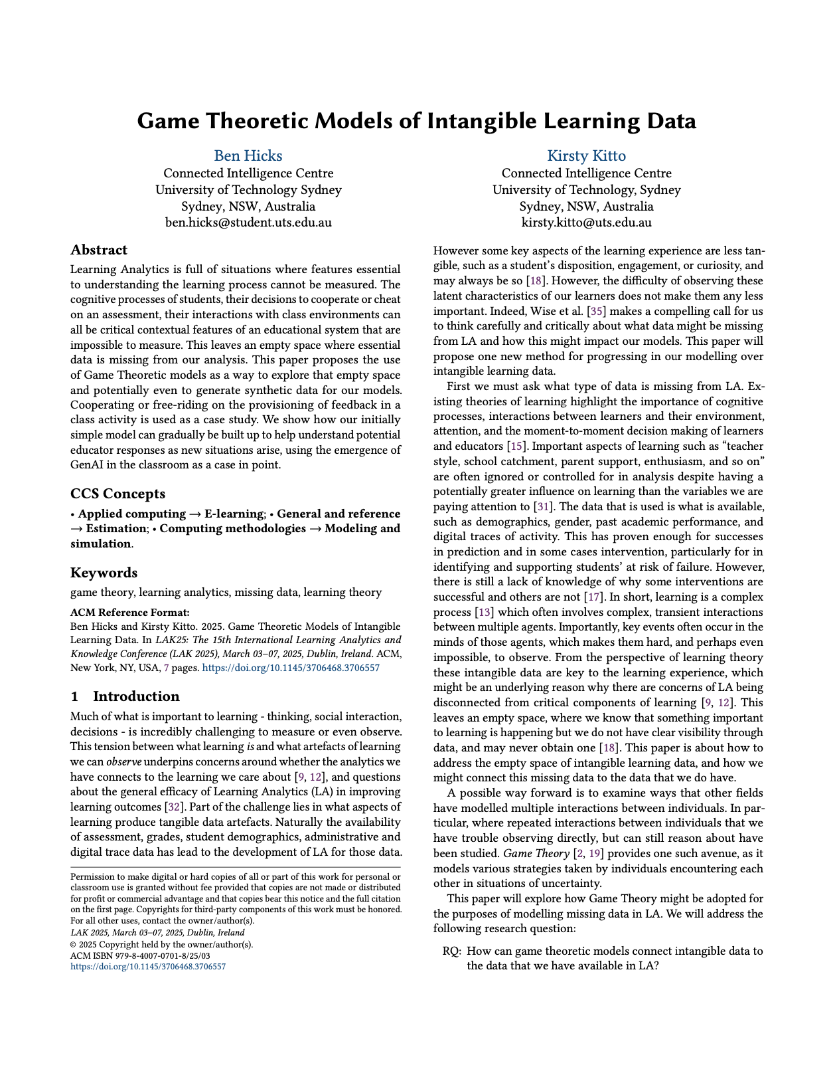


Paper:
Code:

Slide 44
You’ve gone to far Ben, go back
Unless people want more maths…

Slide 45

What’s in it for me? (I’m $R_{j}$)
The value I perceive to get from receiving (R) feedback when person i provides (P) me feedback.

Slide 46
What’s in it for me? (I’m $R_{j}$)
I get some value from the feedback (f) based on how much effort (Theta) Pi puts in (Theta_P_i)

Slide 47
What’s in it for me? (I’m $R_{j}$)
Depending on how much effort I put in (Theta_R_j) I get some benefit (b) but also incur a cost (c).

Slide 48
What’s in it for me? (I’m $R_{j}$)
I also perceive some social benefit from working with people who put in a similar amount of effort.

Slide 49
How much effort should I put in? This is my strategy.
$$V\left(R_{j} | P_{i}\right)={Θ_{P}}_{i}f+(1−|{Θ_{P}}_{i}−{Θ_{R}}_{j}|)a$$
$$V\left(R_{j} | P_{i}\right)={Θ_{P}}_{i}f+b−c+(1−|{Θ_{P}}_{i}−{Θ_{R}}_{j}|)a$$

Slide 50
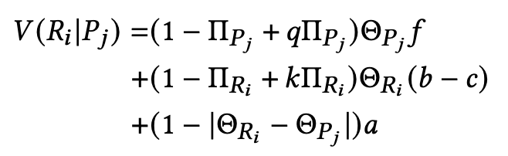
Adding GenAI

Slide 51
Adding GenAI, with quality q and cost reduction k
Old model
Introducing GenAI

